Slide 1
Limited Designs Analytics Roles
Yoel Kortick
Senior Librarian

Slide 2

Agenda
Introduction
Configuration
Sample users and corresponding behavior
Table of subject areas per role
Sample reports and corresponding behavior

Slide 3
Introduction

Slide 4
Introduction
The Limited Designs Analytics Roles provide the staff user access to specific subject areas only.
With these roles, administrators can limit staff users to create and run Analytics reports and DV workbooks only in the subject areas that are within their responsibility.
All reports and workbooks are visible to users with the limited roles, but only ones in the subject areas to which the staff user has access will run successfully for the logged in user.
See also Designs Analytics Roles

Slide 5
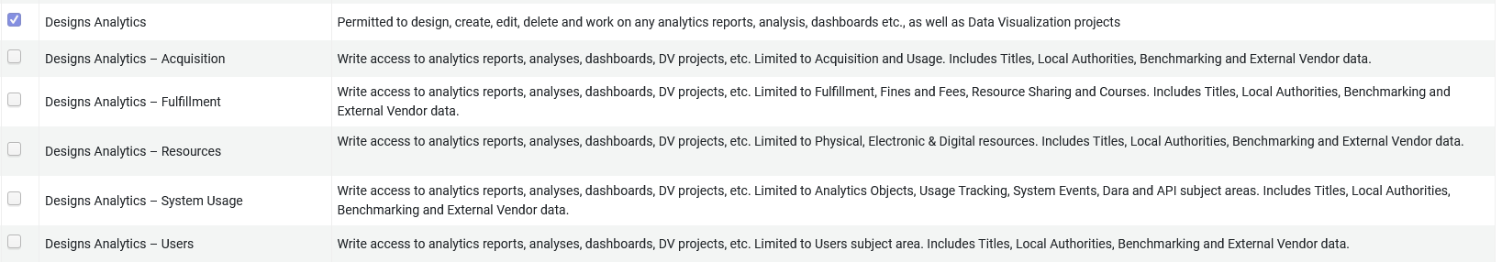
Introduction
The Limited Design Analytics Roles

Slide 6
Introduction
Designs Analytics – Fulfillment:
  limits access to the Course Reserves, Fines and Fees, Fulfillment, Requests, and Borrowing Requests (Resource Sharing) subject areas. Includes Titles, Local Authorities, Benchmark, and External Vendor data.
Designs Analytics – Resources:
  limits access to the Digital Inventory, Digital Usage, Digital Waitlist, E-Inventory, Link Resolver Usage, Local Authorities, Physical Items Historical Events, and Physical Items subject areas. Includes Titles, Local Authorities, Benchmark and External Vendor data.
Designs Analytics – Acquisition:
  limits access to the Purchase Requests, Borrowing Requests, Lending Requests, Funds Expenditure, and Usage Data (COUNTER) subject areas. Includes Titles, Licenses, Local Authorities, Benchmark and External Vendor data. Includes Titles, Local Authorities, Benchmarking and External Vendor data.

Slide 7
Introduction
Designs Analytics – System Usage:
  limits access to Analytics Objects, Analytics Usage Tracking, System Events, DARA, and API Usage subject areas. Includes Titles, Local Authorities, Benchmark and External Vendor data.
Designs Analytics – Users:
  limits access to Users subject area. Includes Titles, Local Authorities, Benchmark and External Vendor data.

Slide 8
Configuration

Slide 9
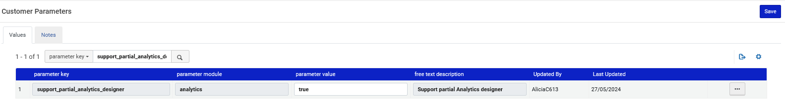
Configuration
In order to use this functionality, the parameter support_partial_analytics_designer” should be set to true.
This is defined at “Configuration > Analytics > General Configuration > Other Settings”

Slide 10
Sample users and corresponding behavior

Slide 11
Sample users and corresponding behavior
Staff user Alicia Chen has role “Designs Analytics”
Staff user Elly May Clampett has role “Designs Analytics – Acquisition”
Staff user Aaron Hacohen has role “Designs Analytics – Fulfillment”
Staff user Madeline Matar has role “Designs Analytics – Resources”

Slide 12
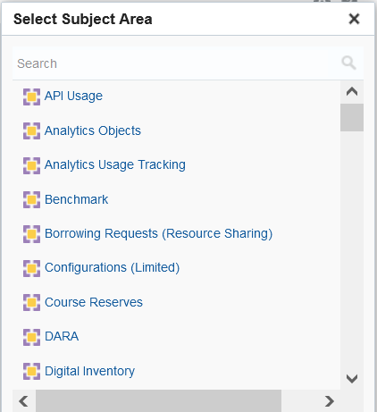
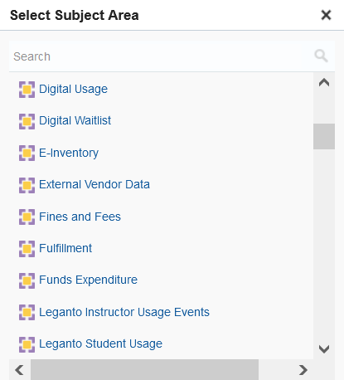
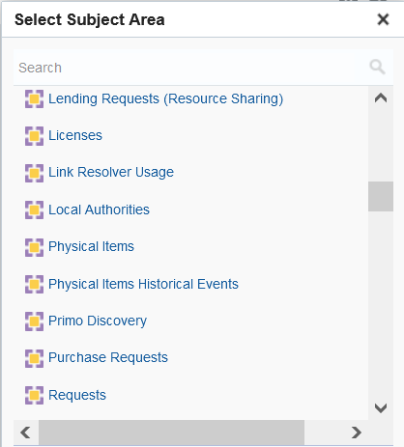
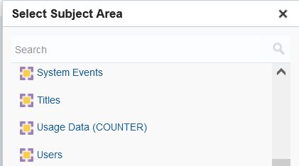
Sample users and corresponding behavior
User Alicia Chen has role Designs Analytics, and therefore she sees all subject areas.

Slide 13
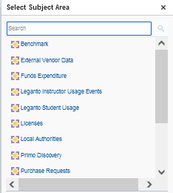
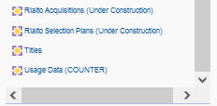
Sample users and corresponding behavior
User Elly May Clampett has role “Designs Analytics – Acquisition” and therefore sees these subject areas.

Slide 14
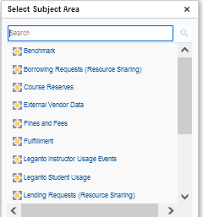
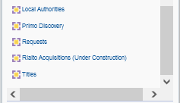
Sample users and corresponding behavior
User Aaron Hacohen has role “Designs Analytics – Fulfillment” and therefore sees these subject areas.

Slide 15
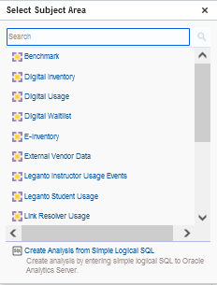
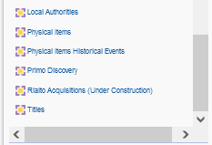
Sample users and corresponding behavior
User Madeline Matar has role “Designs Analytics – Resources” and therefore sees these subject areas.

Slide 16

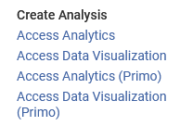
Sample users and corresponding behavior
If a user has only a specific limited “Designs Analytics” role (such as the examples here for Elly May Clampett, Aaron Hacohen, and Madeline Matar) then the user will not see a link to Primo Analytics in the Analytics menu.
If a user has the non limited “Designs Analytics” role (such as the example here for Alicia Chen) then the user will see a link to Primo Analytics in the Analytics menu.
User with a limited “Designs Analytics” role | User with non limited “Designs Analytics” role

Slide 17
Table of subject areas per role

Slide 18
Table of subject areas per role
See Designs Analytics Role, specifically the table under the text “The following table describes the areas that are accessible for the limited roles”.

Slide 19
Sample reports and corresponding behavior

Slide 20
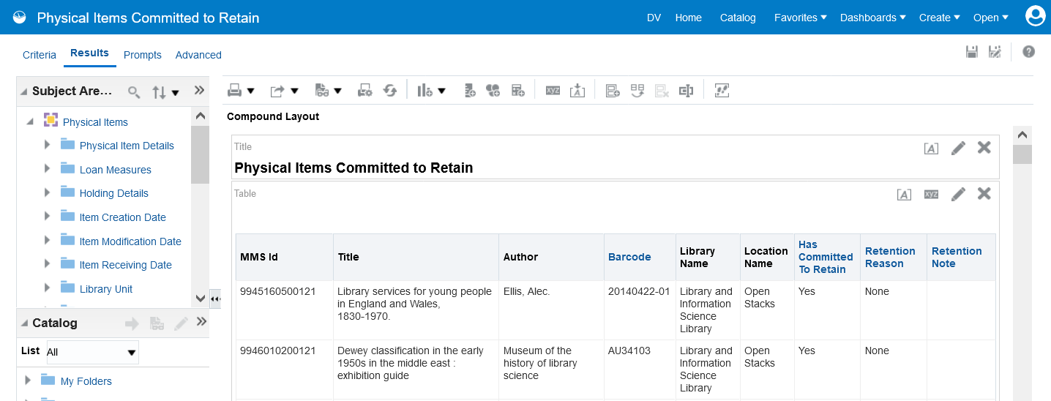
Sample reports and corresponding behavior
Report “Physical Items Committed to Retain” is in the “Physical Items” subject area

Slide 21
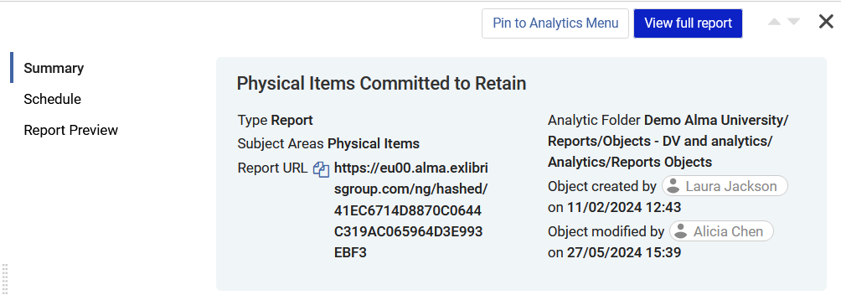
Sample reports and corresponding behavior
If Elly May Clampett (role “Designs Analytics – Acquisition”) tries to open it …

Slide 22
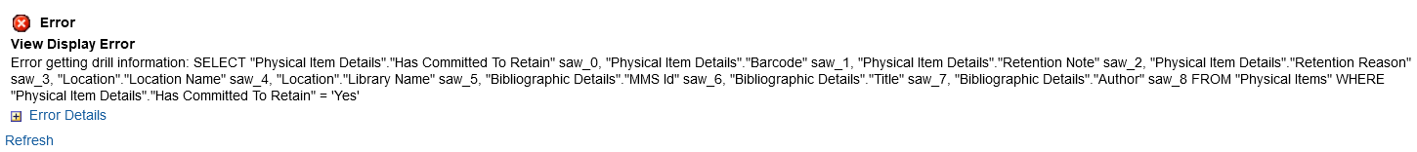
Sample reports and corresponding behavior
She gets this error because she does not have access to the Physical Items subject area

Slide 23
Sample reports and corresponding behavior
If Aaron Hacohen (role “Designs Analytics – Fulfillment”) tries to open it …

Slide 24
Sample reports and corresponding behavior
He gets this error because he does not have access to the Physical Items subject area

Slide 25
Sample reports and corresponding behavior
If Madeline Matar (role “Designs Analytics – Resources”) tries to open it …

Slide 26
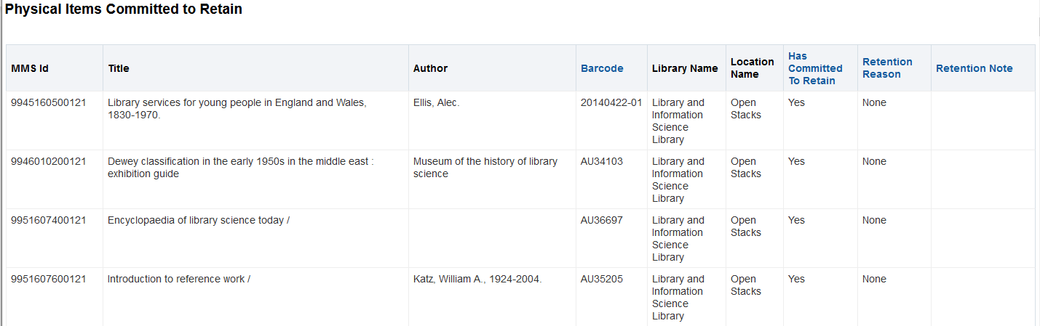
Sample reports and corresponding behavior
She successfully views the report because she does have access to the Physical Items subject area

Slide 27
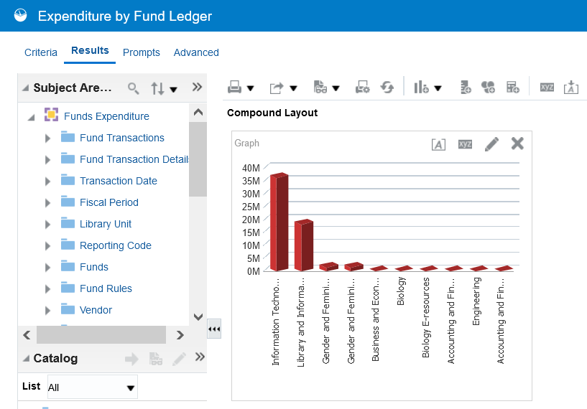
Sample reports and corresponding behavior
Report “Expenditure by Fund Ledger” is in the “Funds Expenditure” subject area

Slide 28
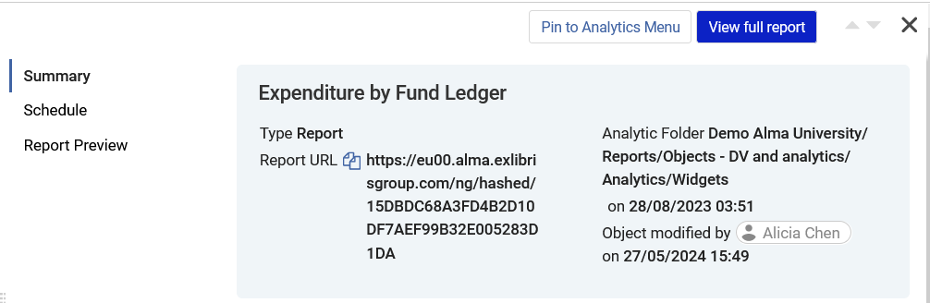
Sample reports and corresponding behavior
If Elly May Clampett (role “Designs Analytics – Acquisition”) tries to open it …

Slide 29
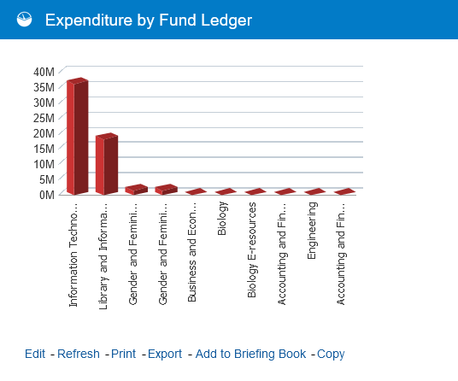
Sample reports and corresponding behavior
She successfully views the report because she does have access to the Funds Expenditure subject area

Slide 30
Sample reports and corresponding behavior
If Aaron Hacohen (role “Designs Analytics – Fulfillment”) tries to open it …

Slide 31
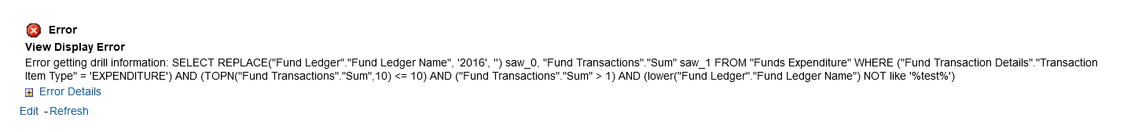
Sample reports and corresponding behavior
He gets this error because he does not have access to the Funds Expenditure subject area

Slide 32
Sample reports and corresponding behavior
If Madeline Matar (role “Designs Analytics – Resources”) tries to open it …

Slide 33
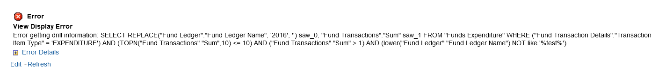
Sample reports and corresponding behavior
She gets this error because she does not have access to the Funds Expenditure subject area

